Slide 2
Microcontroller
Showing
Medical Sensor
Medical Box
Robot Motion

Slide 3
Microcontroller
Showing
Medical Sensor
Medical Box
Robot Motion

Slide 4
Microcontroller
Showing
Medical Sensors
Medical Box
Robot Motion

Slide 5
Microcontroller
Showing
Medical Sensors
Medical Box
Robot Motion

Slide 6
Microcontroller
Showing
Medical Sensors
Medical Box
Robot Motion

Slide 7
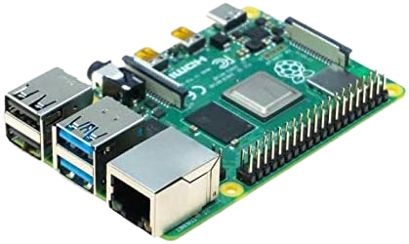
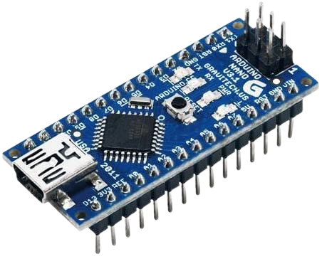
Problems
Microcontroller
Showing
Medical Sensors
COST
Medical Box
CONNECTION
Robot Motion

Slide 8
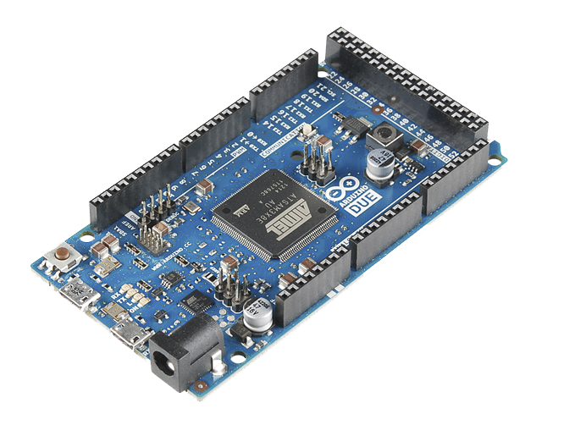
ARDUINO MEGA
Problems
COST
CONNECTION

Slide 9
SHOWING
ARDUINO MEGA
We using this micro controller for many reasons like :
More digital and analog inputs/outputs, and more processing power than other microcontroller boards
Suitable for more complex projects or applications.
LEDS

Slide 10
MEDICAL SENSORS
ARDUINO MEGA
SHOWING
MLX90614 SENSOR
MAX30102 SENSOR
LEDS

Slide 11
What Is Sensor ?
MEDICAL SENSORS
MLX90614 SENSOR
MAX30102 SENSOR

Slide 12
What Is Sensor ?
1 Sensors are devices that detect changes in physical phenomena and send the information to other electronics.
MLX90614 SENSOR
MAX30102 SENSOR
2 They are used in a wide range of applications, from consumer products to industrial and scientific applications.
3 Advances in technology have expanded the capabilities and uses of sensors.
MEDICAL SENSORS

Slide 13
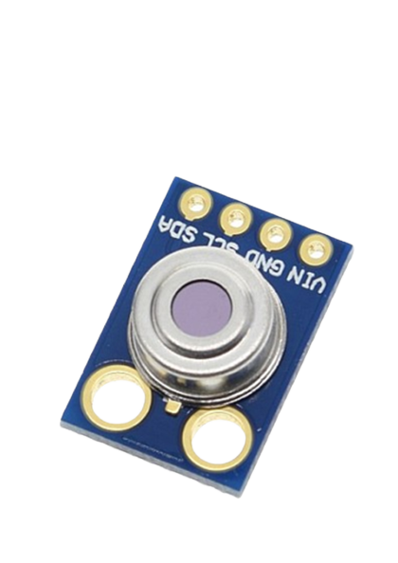
sense temperature(Main)
Accuracy: ±0.5°C
Resolution: ±0.2°C
Distance between object and sensor: 2cm-5cm
MLX90614 SENSOR

Slide 14
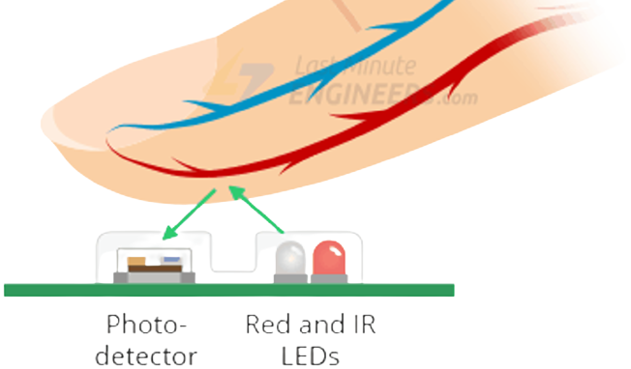
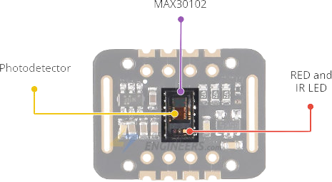
MLX90614 SENSOR
sense temperature(Main)
Accuracy: ±0.5°C
Resolution: ±0.2°C
Distance between object and sensor: 2cm-5cm

Slide 15
MAX30102 SENSOR
SENSING
SPO2
Heart Rate
Reading Temperature (Spare using)

Slide 16
Medical Box

Slide 17
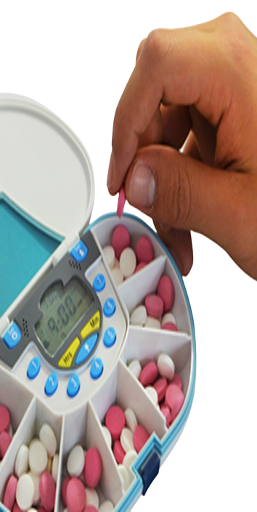
Medical Box
1 The robot reminds patients of medication appointments using sound, an illuminated medicine box and a buzzer.
ROBOT
2 The medicine box is divided into 3 sections for different medication schedules and the robot uses an IR sensor to indicate which section to open.
MOTION
3 IR SENSOR :
We using IR because its cheep and This box will be self open from patient.

Slide 18
ROBOT
MOTION

Slide 19
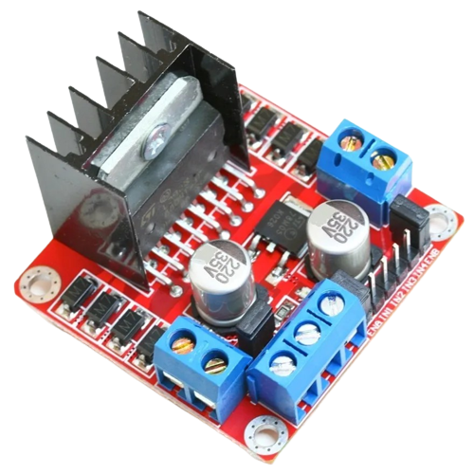
ROBOT
MOTION
ELECTRICAL
MECHANICAL
SOFTWARE

Slide 20
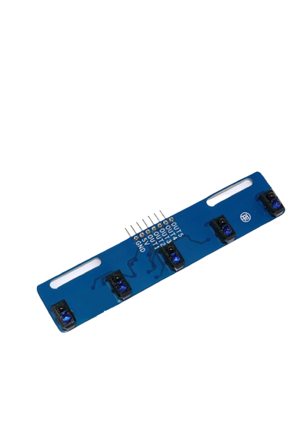
ELECTRICAL
MOTOR DRIVER
Supply voltage: 12V Maximum output current: 2A per channel Module to control two DC motors or one stepper motor The system has a mounted radiator and tile size: 43.5 x 43.5 x 29 mm.

Slide 21
ELECTRICAL
LINE FOLLOWER SENSOR
Sensor Black and White 5 channel line follower sensor with TCRT5000

Slide 22
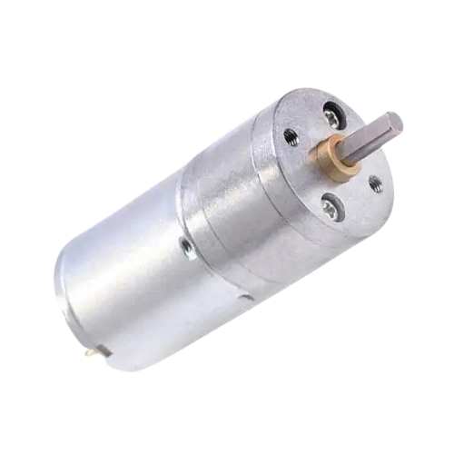
LINE FOLLOWER SENSOR
ROBOT
MOTION
Sensor Black and White 5 channel line follower sensor with TCRT5000
4 DC MOTORS
Operating voltage: between 6 V and 18 V Nominal voltage: 12 V Free-run speed at 12 V: 133 RPM Free-run current at 12 V: 50 mA Stall current at 12 V: 1200 mA Stall torque at 12 V: 20 kg.cm Gear ratio: 1:78 Reductor size: 21 mm
ELECTRICAL
MECHANICAL
SOFTWARE

Slide 23
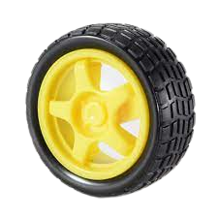
MECHANICAL
4 DC MOTORS
Operating voltage: between 6 V and 18 V Nominal voltage: 12 V Free-run speed at 12 V: 133 RPM Free-run current at 12 V: 50 mA Stall current at 12 V: 1200 mA Stall torque at 12 V: 20 kg.cm Gear ratio: 1:78 Reductor size: 21 mm

Slide 24
MECHANICAL
WHEELS
1. Rubber
2. Light

Slide 25
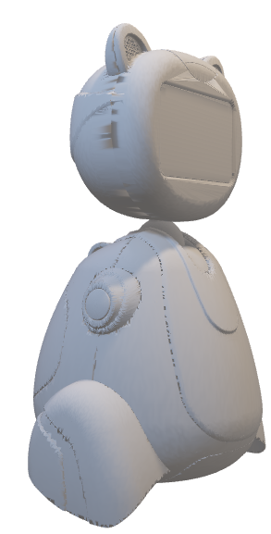
LINE FOLLOWER SENSOR
ROBOT
MOTION
Sensor Black and White 5 channel line follower sensor with TCRT5000
4 DC MOTORS
Operating voltage: between 6 V and 18 V Nominal voltage: 12 V Free-run speed at 12 V: 133 RPM Free-run current at 12 V: 50 mA Stall current at 12 V: 1200 mA Stall torque at 12 V: 20 kg.cm Gear ratio: 1:78 Reductor size: 21 mm
ELECTRICAL
MECHANICAL
SOFTWARE

Slide 26
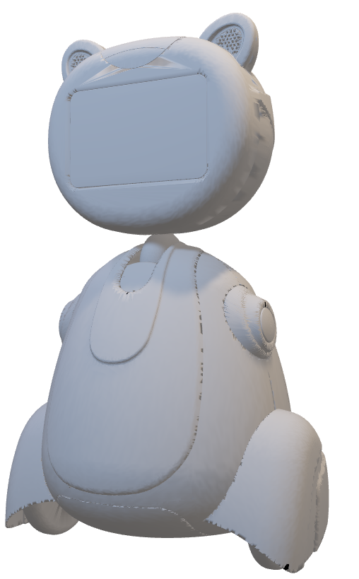
SOFTWARE
LINE FOLLOWER :
Functions of Motion are :
Forward
Left
Backward
Right

